Slide 1
A Project on Customer Churn Prediction

Slide 2
Contributors
Name | Email | Country | College/Company | Specialization
Fabian Umeh | Fabianumeh335@gmail.com | UK | Teesside University | Data Science
Rukevwe Ovuowo | rukevwe10@gmail.com | Nigeria | GBG Data science Academy | Data Science
Olutayo Oladeinbo | oladeinboolutayo@yahoo.com | UK | Teesside University | Data Science

Slide 3

Problem statement Churn rate is a marketing metric that describes the number of customers who leave a business over a specific time. Every user is assigned a prediction value that estimates their state of churn at any given time.
Business Understanding Browsing behavior Historical purchase data among other information It factors in our unique and proprietary predictions of how long a user will remain a customer.
This score is updated every day for all users who have a minimum of one conversion. The values assigned are between 1 and 5.

Slide 4


Risks Data

Slide 5
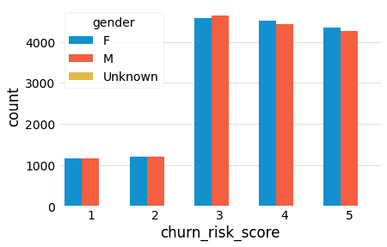
Both male and female customers have nearly equal rates of churn risk in the data group collected

Slide 6
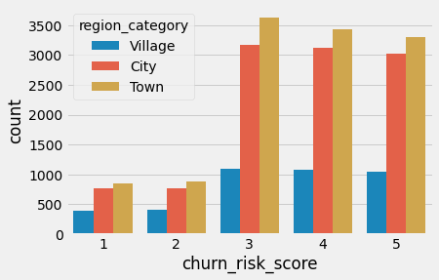
There are lesser chances of customers from the village to churn when compared to customers from cities and towns

Slide 7
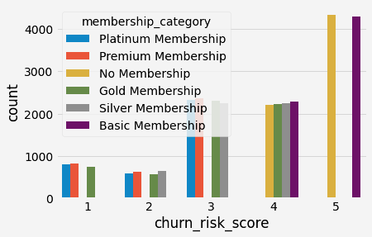
Customers with basic or no membership category shows the highest churn risk score

Slide 8
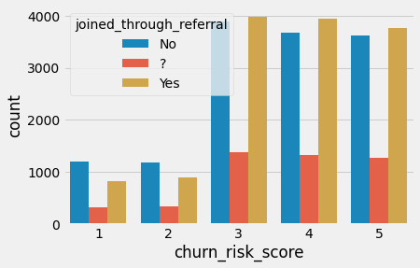
The data collected for shows no meaningful difference I churn risk between customers who joined through referrals and those who did not

Slide 9
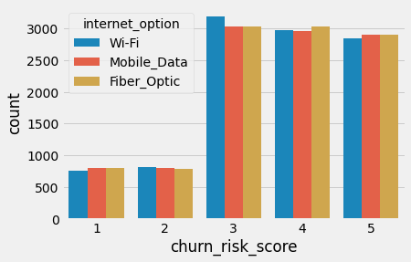
Internet options does not reveal any meaningful bearing on customer churn risks

Slide 10
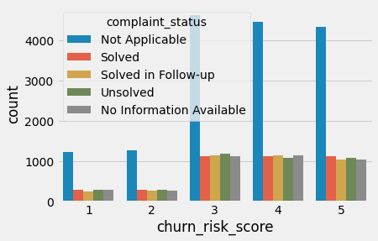
Most complaints made by customers are usually ‘Not applicable’

Slide 11
Model Used
Random Forest Classifier
K Nearest Neighbours Classifier
Multi-layer Perceptron Classifier
Neural Network (Three layers)

Slide 12
Title
Body copy here

Slide 13
Title

Slide 14

Thank You

